Slide 1
Multiple Covariate Regression Models for Survival Analysis for CRC using SEER*Stat Data
Qianqian Yao

Slide 2
Contents
Background & Motivation
Data
Methodologies & Analysis
Conclusion

Slide 3
Background & Motivation
Background
Colorectal cancer is the second most common cause of cancer death in the United States.
Survival analysis is an essential indicator for effective early detection and improvements in treatments.
Motivation
Obtain dataset from SEER*Stat database
Apply methodologies of Kaplan-Meier estimator and Log-Rank test to find insights on how treatments affect survival analysis
Test whether treatment variables are significant in Cox regression model

Slide 4
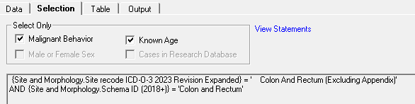
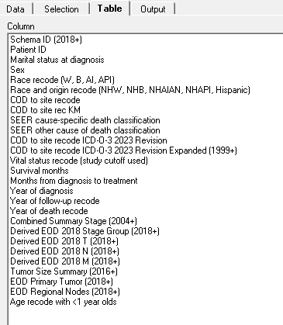
Dataset: SEER*Stat
Filter:
ICD-0-3-2023 Revision Expanded
Schema ID 2018

Slide 5
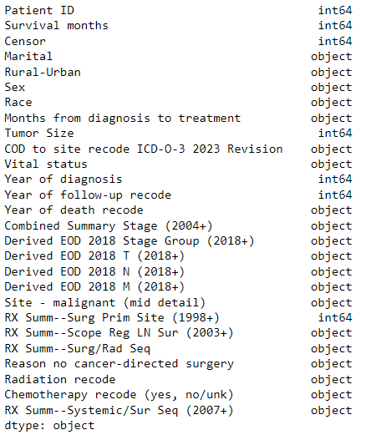
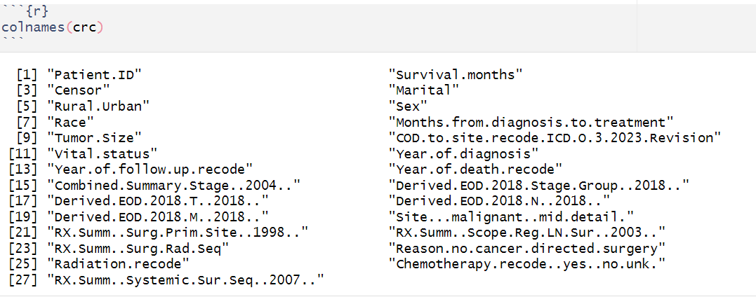
Dataset: Censoring
If Vital Status = Alive: Censor = 0;
If Vital Status = Dead and COD no = Colon and Rectum: Censor = 0;
If Vital Status = Dead and COD = Colon and Rectum: Censor = 1;
Censor = 1 means that the individual failed and survival time is certain;
Censor = 0 means that the individual’s survival time is not certain;
Notes:
After the dataset is obtained, censoring is processed.
The bottom picture is columns in the dataset,
The right side picture is the data type of variables in the dataset.

Slide 6
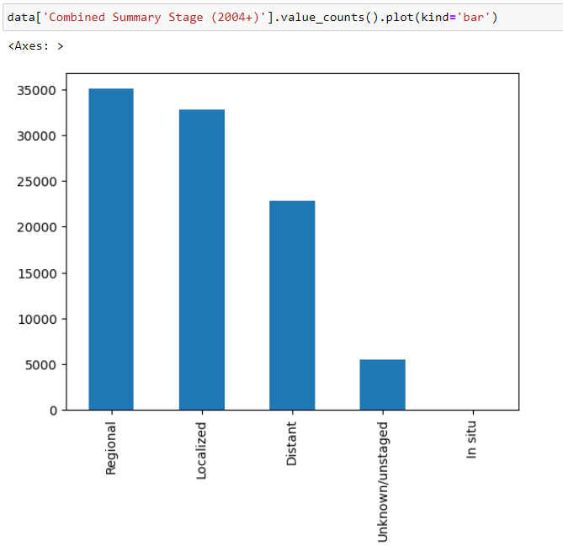
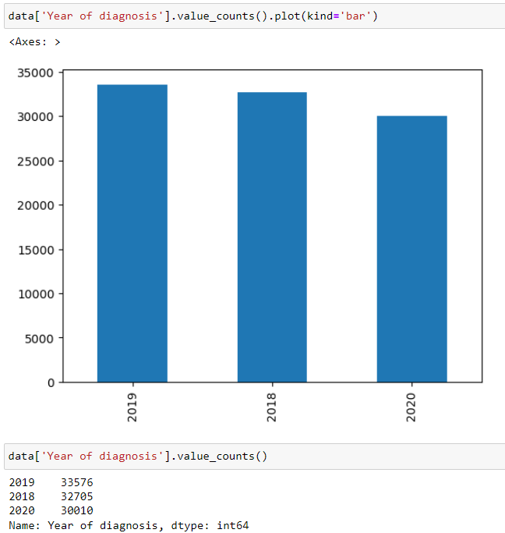
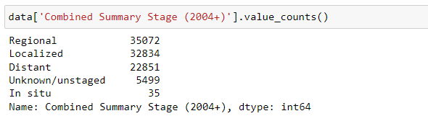
Dataset: Year of Diagnosis, Stages
Notes:
This dataset contains diagnosis of three years: 2018, 2019, 2020;
Staging contains 0- in-situ; 1-Localized ; 2-Regional ; 3-Distant

Slide 7
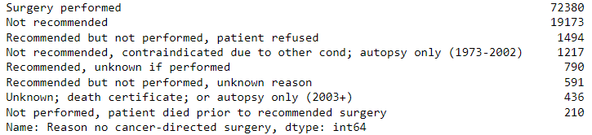
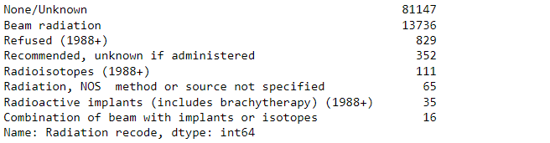
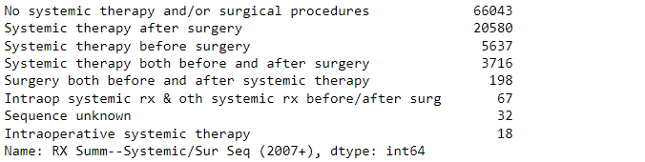
Dataset: Treatments
Interested Variables: Stage and Treatment
Stage | 0- In-Situ; 1-Localized ; 2-Regional ; 3-Distant
Surgery | Surgery Performed, Recommended, unknown if performed, Recommended but not performed, Unknown, Death Certificate, Not recommended, Not recommended Contraindicate, Not performed,
Radiation | Combination of beam, Radiation, Beam radiation, Recommended, unknown if administered, Unknown, Radioisotopes, Radioactive implants, Refused,
Systematic Therapy | Systemic therapy both before and after surgery, Systemic therapy before surgery, Surgery both before and after systemic therapy, Therapy after surgery, Intraoperative therapy, Sequence unknown, No systemic therapy and/or surgical procedures,
Notes:
Surgery: surgery is a procedure in which a surgeon removes cancer from your body
Radiation: uses high doses of radiation to kill cancer cells and shrink tumors.
Systematic Therapy is to use drug treatments that will damage or kill cancer cells. Chemotherapy is one type of systemic therapy.
This table shows categories in each treatment.
Biomarker testing for cancer treatment,
Hormone therapy,
Hyperthermia,
Immunotherapy,
Photodynamic therapy,
Stem cell transplant,
Targeted therapy,

Slide 8
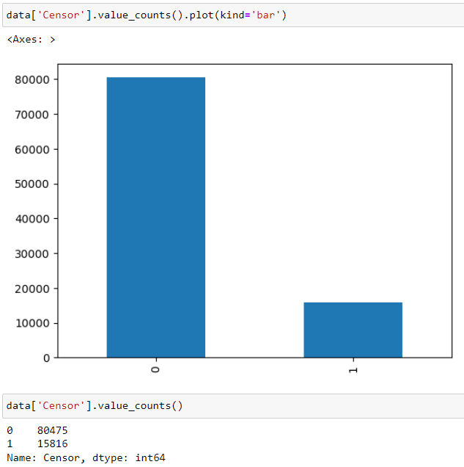
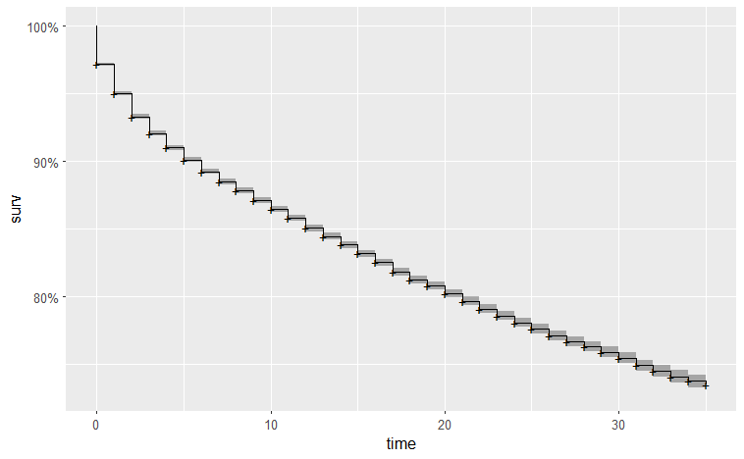
1- Kaplan-Meier Estimator & Log-Rank Test
84%Censored
16%Failed
Notes:
There are 84% censored items, and 16% failed

Slide 9
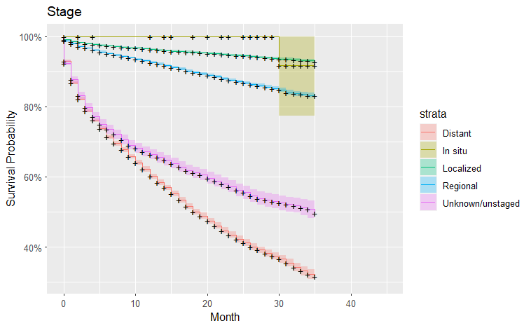
1- Kaplan-Meier Estimator & Log-Rank Test
Staging Variable
0- In Situ,
1- Localized,
2- Regional,
3- Distant
Rho=0: P_value = <2e-16
Rho=1: P_value = <2e-16
The earlier the detection, the higher the survival rate
Notes:
Staging variable includes 0- In-Situ; 1-Localized ; 2-Regional ; 3-Distant
By log-rank test, we can see that p-value is almost zero, there are differences among each category.
From highest to lowest survival rate, it is in-situ, localized, regional, distant.

Slide 10
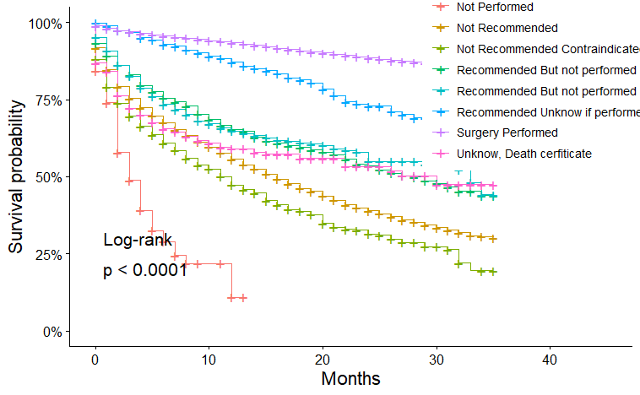
1- Kaplan-Meier Estimator & Log-Rank Test
Treatment of Surgery
Surgery Performed,
Recommended, unknown if performed,
Recommended but not performed,
Unknown, Death Certificate,
Not recommended,
Not recommended Contraindicate,
Not performed,
Rho=0: P_value = <2e-16
Rho=1: P_value = <2e-16
Surgery should be performed if recommended
Notes:
surgery is a procedure in which a surgeon removes cancer from your body.
Within treatment of Surgery, there are surgery performed, recommended, recommended but not performed, unknown, not recommended, not performed.
By log-rank test,
From highest to lowest survival rate: surgery performed has the highest survival rate, surgery not performed has the lowest survival rate.

Slide 11
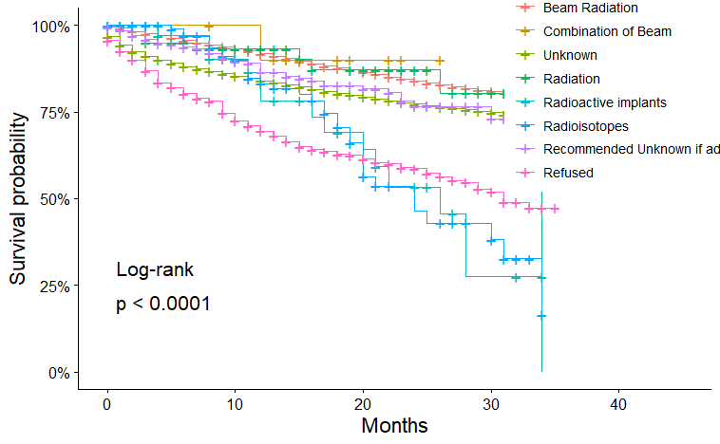
1- Kaplan-Meier Estimator & Log-Rank Test
Treatment of Radiation
Combination of beam,
Radiation,
Beam radiation,
Recommended, unknown if administered,
Unknown,
Radioisotopes,
Radioactive implants,
Refused,
Rho=0: P_value = <2e-16
Rho=1: P_value = <2e-16
Notes:
Radiation: uses high doses of radiation to kill cancer cells and shrink tumors.
Within treatment of Radiation, there are combination of beam, radiation, beam radiation, radioisotopes, radioactive implants, refused.
By log-rank test,
From highest to lowest survival rate:
Beam radiation, combination of beam, radiation have higher survival distribution.
Radioisotopes and radioactive implants have higher survival rate but the survival rate drops down faster.

Slide 12
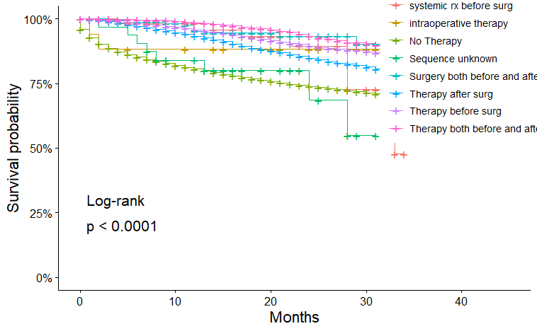
1- Kaplan-Meier Estimator & Log-Rank Test
Treatment of Systematic Therapy
Systemic therapy both before and after surgery,
Systemic therapy before surgery,
Surgery both before and after systemic therapy,
Therapy after surgery,
Intraoperative therapy,
Sequence unknown,
No systemic therapy and/or surgical procedures,
Rho=0: P_value = <2e-16
Rho=1: P_value = <2e-16
Systematic therapy generally helps.
Notes:
Systematic Therapy: includes a large group of drug treatments that will damage or kill cancer cells.
Within treatment of Systematic Therapy, there are …
By log-rank test, we can conclude that …
From highest to lowest survival rate:
Generally speaking, patients who have systematic therapy have higher survival rates than those who don’t have.

Slide 13
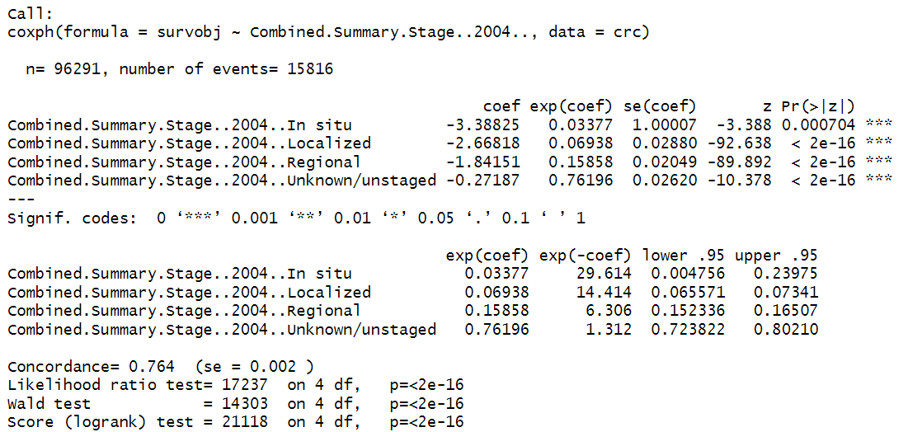
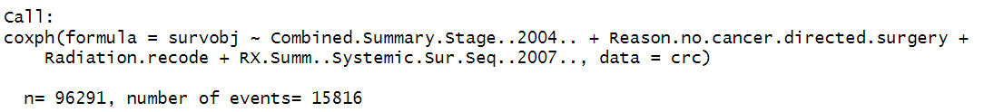
2- Cox Repression Model
Model1:
Stage Variable
Model2:
Stage Variable + Treatments
Surgery
Radiation
Chemotherapy
Systematic Therapy
Notes:
After using Kaplan Meier and log rank test, we can use cox regression model to fit a linear regression.
There are two cox regression models: the first only contains stage variable, the second contains stage variable and treatment variables.

Slide 14
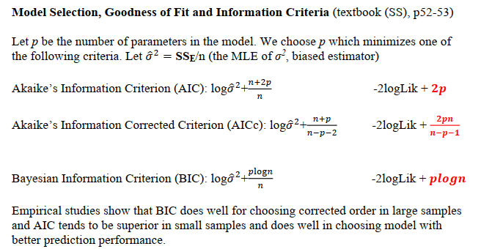
2- Cox Repression Model
Model | AIC | -2logLik
Model1 | 331612.9 | 331604.9 (df=4)
Model2 | 325241 | 325191 (df=25)
Notes:
Then evaluation on two models are done by AIC and log likelihood criteria.
The lower value indicates a better model.

Slide 15
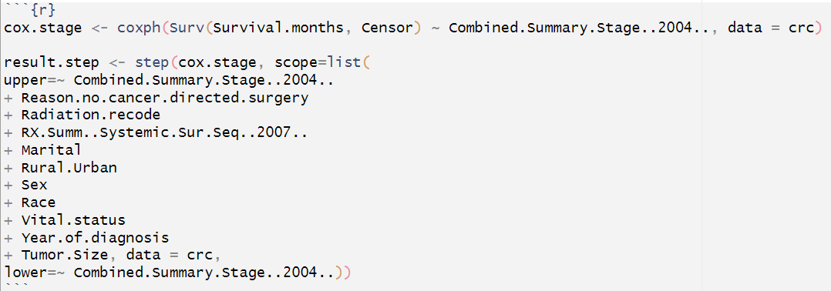
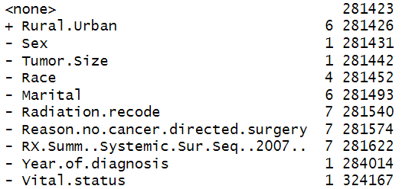
2- Cox Repression Model
Step function to identify the model with lowest AIC, do not select the variables
DF
AIC

Slide 16
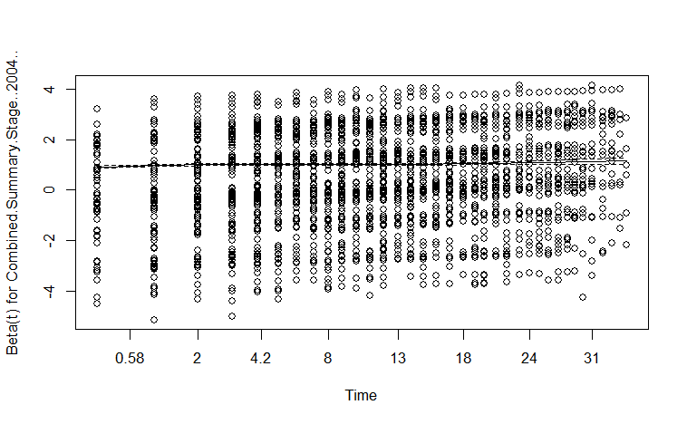
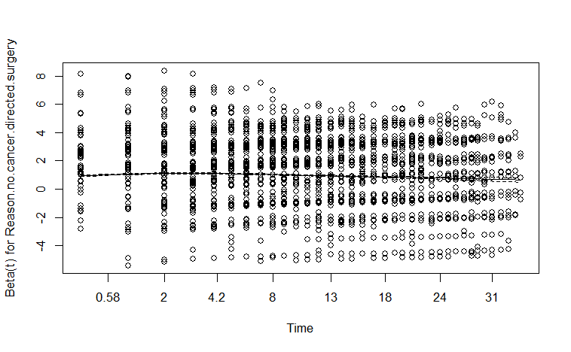
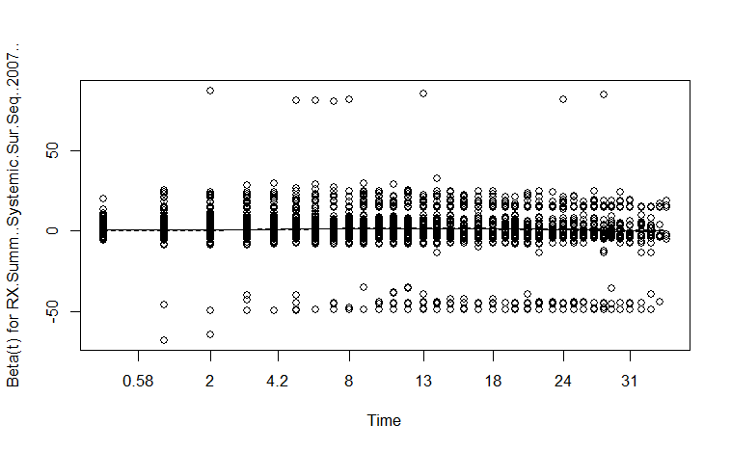
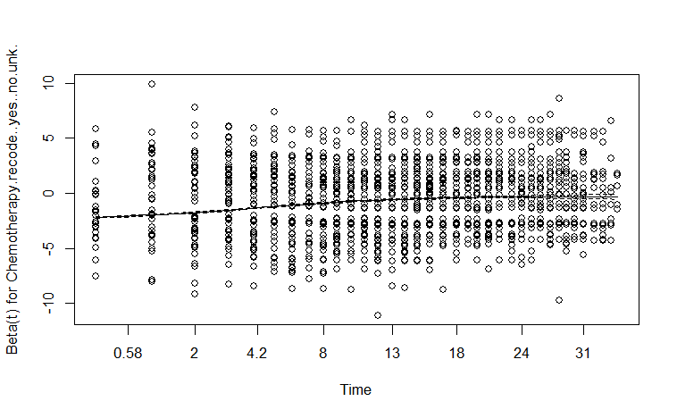
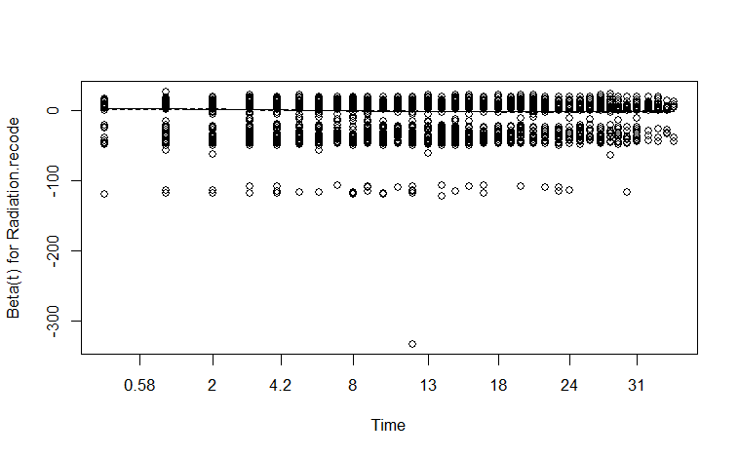
2- Cox Repression Model
Notes:
this slide is to check constant hazard ratio, which is the assumption of the model.
We can see that the model assumptions are satisfied.

Slide 17
Conclusion
Treatment Variables:
Surgery: Surgery is better to perform if it is recommended.
Radiation: Beam radiation have better survival rate at later phase; Patients who did Radioisotopes and Radioactive implants have better survival rate at the beginning phase, later the survival rate drops.
Systematic Therapy: helps to improve survival rate.
Cox Regression Models:
The treatments are statistically significant in cox regression model.
More variables can be included in the model, including geographic, tumor size, and use step() function to identify a model with lowest AIC value.

Slide 18
Reference
Joel S. Brown, Sarah R. Amend, et al. (2023). Updating the Definition of Cancer. Updating of the Definition of Cancer. Molecular Cancer Research 2023; 21:1142-7. DOI: 10.1158/1541-7786.MCR-23-0411.
Rebecca L. Siegel MPH, Nikita Sandeep Wagle MBBS, et al. (2023). Colorectal Cancer Statistics, 2023. CA Cancer J Clin. 2023; 73:233-254. DOI: 10.3322/caac.21772.
Konstantina Kourou, Konstantinos P. Exarchos, et al. (2021). Applied machine learning in cancer research: a systematic review for patient diagnosis, classification and prognosis. ElSEVIER Computational and Structural Biotechnology Journal 19 (2021) 5546-5555. DOI: https://doi.org/10.1016/j.csbj.2021.10.006.
Fadi Alharbi, Aleksandar Vakanski. (2023). Machine Learning Methods for Cancer Classification Using Gege Expression Data: A Review. Bioengineering 2023, 10, 173. DOI: https://doi.org/10.3390/ bioengineering10020173.
Enrico Moiso, Alexander Farahani, et al. (2022). Developmental Deconvolution for Classification of Cancer Origin. Cancer Discov 2022; 12-2566-85. DOI: 10.1158/2159-8290.CD-21-1443.
Laura Banias, Ioan Jung, et al. (2022). From Dukes-MAC Staging System to Molecular Classification: Evolving Concepts in Colorectal Cancer. International Journal of Molecular Sciences, 2022, 23, 9455. DOI: https:// doi.org/10.3390/ijms23169455.
Samar Abd ElHafeez, Graziella Darrigo, et al. (2021). Methods to Analyze Time-to-Event Data: The Cox Regression Analysis. Oxidative Medicine and Cellular Longevity, Volume 2021, Article ID 1302811. DOI: https://doi.org/10.1155/2021/1302811.
Brandon George, Samantha Seals, et al. (2014), Survival analysis and regression models. J Nucl Cardiol. 2014 August, 21(4): 686–694. DOI :10.1007/s12350-014-9908-2.

Slide 19
THANKS
Q & A

